Slide 1
Predictive Modeling for Bank Marketing
max growth

Slide 2
Introduction : Bank Marketing Campaign
Abstract
Data Set Info
Objective
The data is related with direct marketing campaigns (phone calls) of a Portuguese banking institution. The classification goal is to predict if the client will subscribe to a term deposit (variable y).
This data pertains to direct marketing campaigns conducted by a Portuguese bank through phone calls from May 2008 to November 2010. It involves multiple contacts with clients to determine their subscription to a bank term deposit ('yes' or 'no').
This project's main goal is to create a predictive model that can accurately forecast whether a client will sign up for a term deposit or not.

Slide 3
Business Questions
What are the key factors influencing a client's decision to subscribe to a term deposit, and how can we optimize our marketing strategies to increase the subscription rate based on these insights?
Which of our past marketing campaigns were most effective, and what can we learn from them to improve future campaigns?

Slide 4
Opportunities and Motivations
Customer Segmentation: Identify distinct customer groups for tailored marketing.
Optimizing Campaigns: Allocate resources efficiently for effective marketing.
Predictive Modeling: Create models to target potential clients accurately.
Customer Retention: Understand and improve client satisfaction.
Cost Reduction: Optimize less effective aspects of campaigns
Risk Assessment: Evaluate marketing decision risks.
Data-Driven Decisions: Make informed, objective choices.
Competitive Advantage: Outperform competitors through prediction.

Slide 5
Analysis Process

Slide 6
Data Analysis Process
Raw Bank Dataset
Data Preprocessing
Exploratory Data Analysis
Data Splitting
Feature Engineering
Model Building
Performance Evaluation
Insights & Conclusion

Slide 7
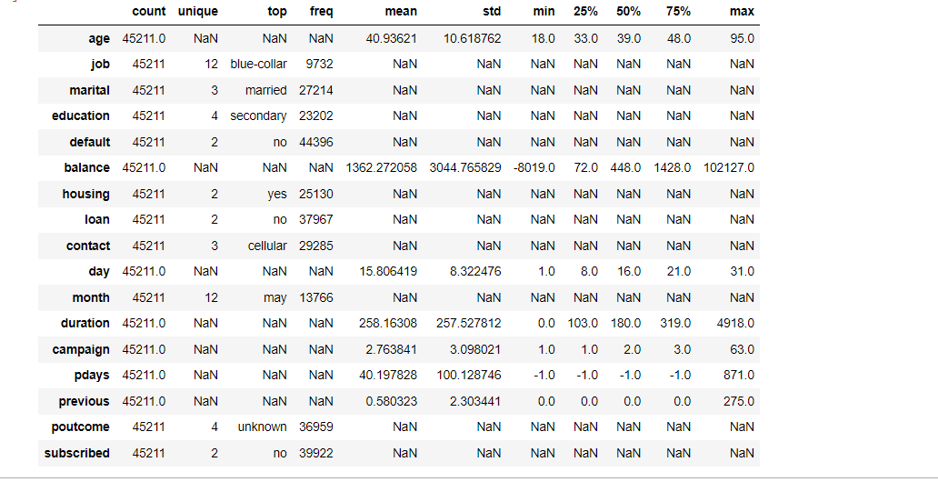
Understanding the data
Data Preprocessing
The dataset includes 17 features with 7 numerical variables and 10 categorical variables.
No duplicate data was found.
No null values were found, but there are a few features that contain unknowns.
The summary statistics reveal the presence of outliers in data

Slide 8
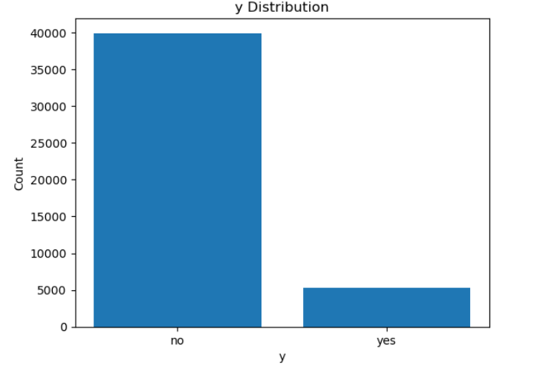
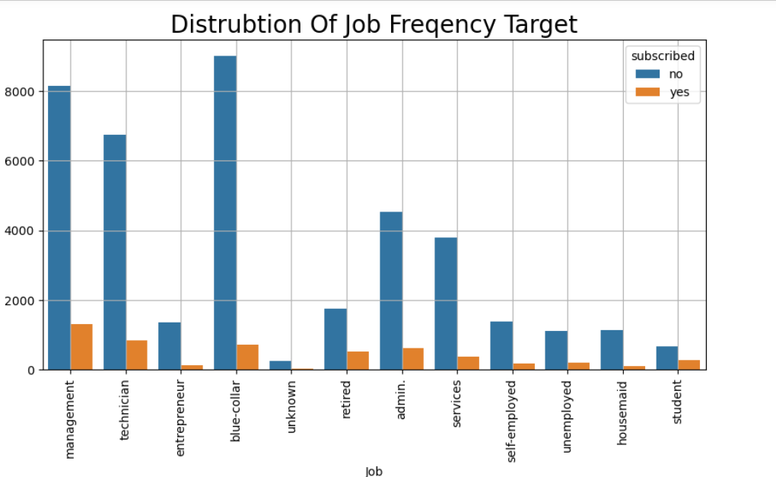
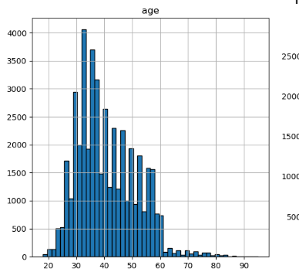
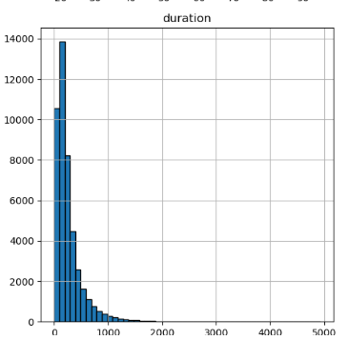
Exploring the data distributions
EDA
Imbalance in the target variables.
Most customers seem to be from the 30 - 45 age group.
The Age distribution highlights the need to adjust marketing tactics to appeal to middle-aged consumers
This distribution implies that a significant percentage of calls are of a considerable length
Majority of the job categories don’t subscribe to the term deposits; however, this imbalance is greater in management jobs, technicians and blue-collar jobs while it is lower in retired clients and students.

Slide 9

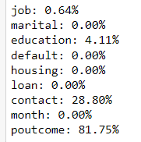
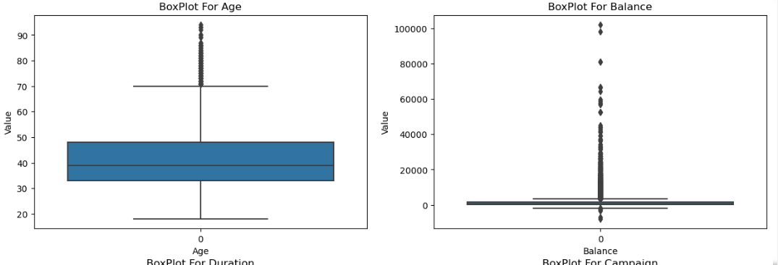

Engineering the data for better performance
Feature Engineering
The “poutcome” variable has significant amount of unknowns.
Dropping the “poutcome” variable.
Scaling the variables with Robust Scaler which handles outliers better than Standard Scaler.
Encoding categorical variables with pandas method
Note: Data was split before feature engineering to prevent data leakage

Slide 10

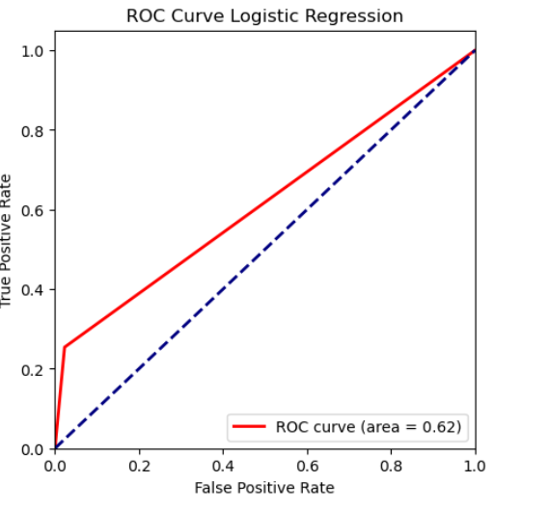
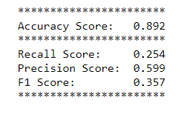

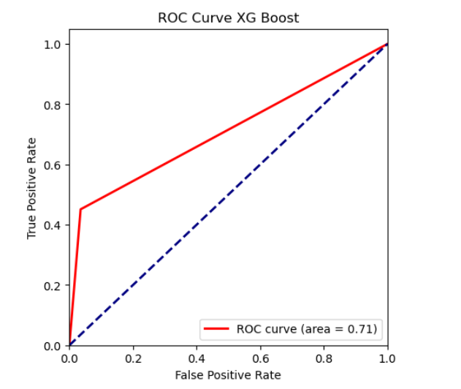
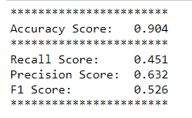
Modelling the data
Model Building
Build the below models :
Logistic Regression
KNN
Decision Tree
Random Forest
XGBoost
Performed hyperparameter tuning with gridsearch and randomsearch.
Used Randomsearch to run the models quicker for models with large hyperparameters.
Build the ROC-Curve to check for classification robustness as well.
Checked for accuracy , recall, precision and F1 scores.
Best hyperparameters selected in grid search/random search were based on best accuracy

Slide 11
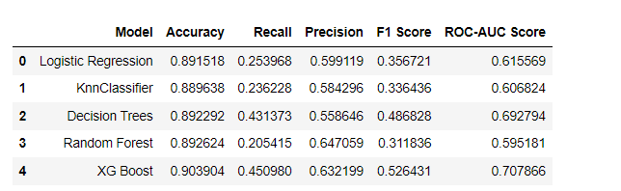
Evaluating the model performance
Performance Evaluation
Each model has advantages and disadvantages, but XG boost performs the best over all other models overall.
In a marketing effort when identifying potential clients is crucial, XG BOOST model may be more desired as it is better at catching potential subscribers.
XG Boost's ROC-AUC score of 0.70 suggests that the model does a good job of differentiating between the positive and negative classes.
Random Forest has an accuracy of 89.2% and a highest precision among all the models but a lower ROC score than XG boost
Since XG boost is also good at handling imbalances , this would be the best model for this analyses.

Slide 12
Conclusion

Slide 13
Overview for the bank
Insights and Conclusions
If the bank wants to ensure they reach as many potential subscribers as possible (even at the risk of targeting some who won't subscribe), they might prioritize models with high Recall.
If the bank wants to ensure that their marketing or outreach efforts are more precise and cost-effective (targeting only those most likely to subscribe), they might prioritize Precision (like in Random Forest).
XG Boost appears to be the best-balanced model with the highest accuracy, and decent Recall and Precision. This might be the bank's best option for a well-rounded approach.
The bank should also consider the costs associated with false positives (clients incorrectly predicted to subscribe) and false negatives (potential subscribers the model misses). Balancing these costs will help in choosing the most economically beneficial model.
The particular objectives of bank's marketing strategy should guide their decision when selecting one of these models. It seems like XG Boost is a superior option if getting more subscribers is their top priority.
Our recommendation would be to use XG boost model as the F1 score of 52.6% is balancing the costs and a descent ROC score suggests a robust classification.

Slide 14
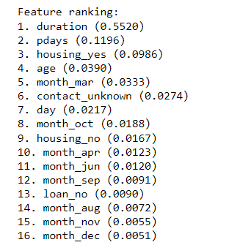
Feature importance ranking
"What are the key factors influencing a client's decision to subscribe to a term deposit, and how can we optimize our marketing strategies to increase the subscription rate based on these insights?"
The top 3 most important features that influence a client's decision to a term deposits per decision trees are Call Duration , the number of days that passed after the client was last contacted from a previous (pdays) and whether the client has housing loan
The most important feature according to your model is the duration of the last contact in seconds. Longer conversations with clients appear to have a significant influence on the decision to subscribe to a term deposit.
These feature importance scores help us understand which aspects of our data are most predictive of subscription decisions. We can use this information to focus on the most influential features when designing marketing campaigns or making business decisions.
Focus marketing efforts on clients with attributes that are highly ranked in feature importance
Use client segmentation to tailor marketing messages. For example, create different marketing strategies for younger clients and older clients based on the "Age" feature.

Slide 15
Challenges and way forward

Slide 16
Challenges and way forward
Challenges Faced:
The data was greatly imbalanced and we had to drop one variable due to lot of unknowns.
Computational power for advanced models like RF, DT, XG Boost
Way Forward
Use other methods for outlier handling and compare
Use grid search after random search to optimize performance further
Address imbalance in the data set

Slide 17
Appendix

Slide 18
Logistic Regression :
Interpretability: Logistic regression is simple to interpret, making it valuable in a business context where explaining the model's predictions is important.
Baseline Model: It's a common choice as a baseline model for binary classification problems, helping to gauge the performance of more complex models.
K-Nearest Neighbors (KNN) :
Non-Parametric: KNN is non-parametric, meaning it doesn't make strong assumptions about the underlying data distribution. This can be advantageous when the true data distribution is unknown.
Local Patterns: KNN can capture local patterns in the data, which can be useful when predicting customer behavior influenced by nearby data points.
Decision Tree :
Interpretability: Decision trees are easy to visualize and understand, which can be helpful for explaining the factors influencing a decision.
Feature Importance: Decision trees provide feature importance scores, aiding in identifying key drivers of the binary response.

Slide 19
Random Forest :
Ensemble Learning: Random Forest is an ensemble of decision trees, which often leads to improved performance over single decision trees by reducing overfitting and increasing predictive accuracy.
Robustness: Random Forest is robust to outliers and noisy data, which is important in real-world datasets.
Gradient Boosting Machines (e.g., XGBoost):
High Predictive Accuracy: Gradient boosting methods, such as XGBoost, are known for their high predictive accuracy and ability to handle complex, non-linear relationships in the data.
Model Optimization: XGBoost includes regularization techniques that help prevent overfitting and improve the model's generalization capabilities.
Handling Class Imbalance: Gradient boosting can effectively handle class imbalance problems, which are common in binary classification tasks.

